Slide 1

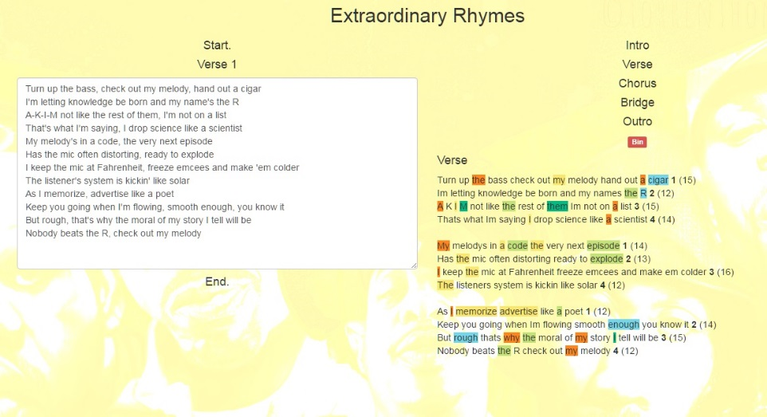
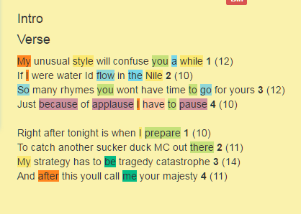
Extraordinary Rhymes
By James Yen
Extraordinary Rhymes is…
A simple client-side web app for writing and composing song lyrics. It features rhyme highlighting, syllable counting, bar counting, and a drag-n-drop part interface (re; Verse, Chorus, etc.).
Presented on: May 5th, 2017
General UI:
Syllable counting,
bar counting.
Features:
Partition song lyrics into sections.
Detect rhymes and highlight rhymes.
Annotate bar lines.
Save lyrics.
Afterword:
I was never able to incorporate any true AI into the rhyming, and of course, the API used (Datamuse) could not completely map all rhymes. This project nevertheless represents my love for music.
Song used in poster:
Eric B. & Rakim – My Melody
Rhyme detection.
Motivation:
Although most lyricists do not use a ‘lyric editor’, this project seemed like a fun intersection of technology and art.

